Slide 1
Local Regression and Generalized Additive Models
Ragheed Al-Dulaimi

Slide 2
Intro to Local Regression
Another method to fit flexible non-linear function
Involve computing the fit at a target point X₀ using the nearby observation only (training points)
Similar to splines, but differs in :
The regions are allowed to overlap (very smooth overlap)
Notes:
Smooting splines partition the data and fit separate piecewise regressions to each section, smoothing them together where then join. While localrregression essentially fit local polynomial regressions and join them together

Slide 3
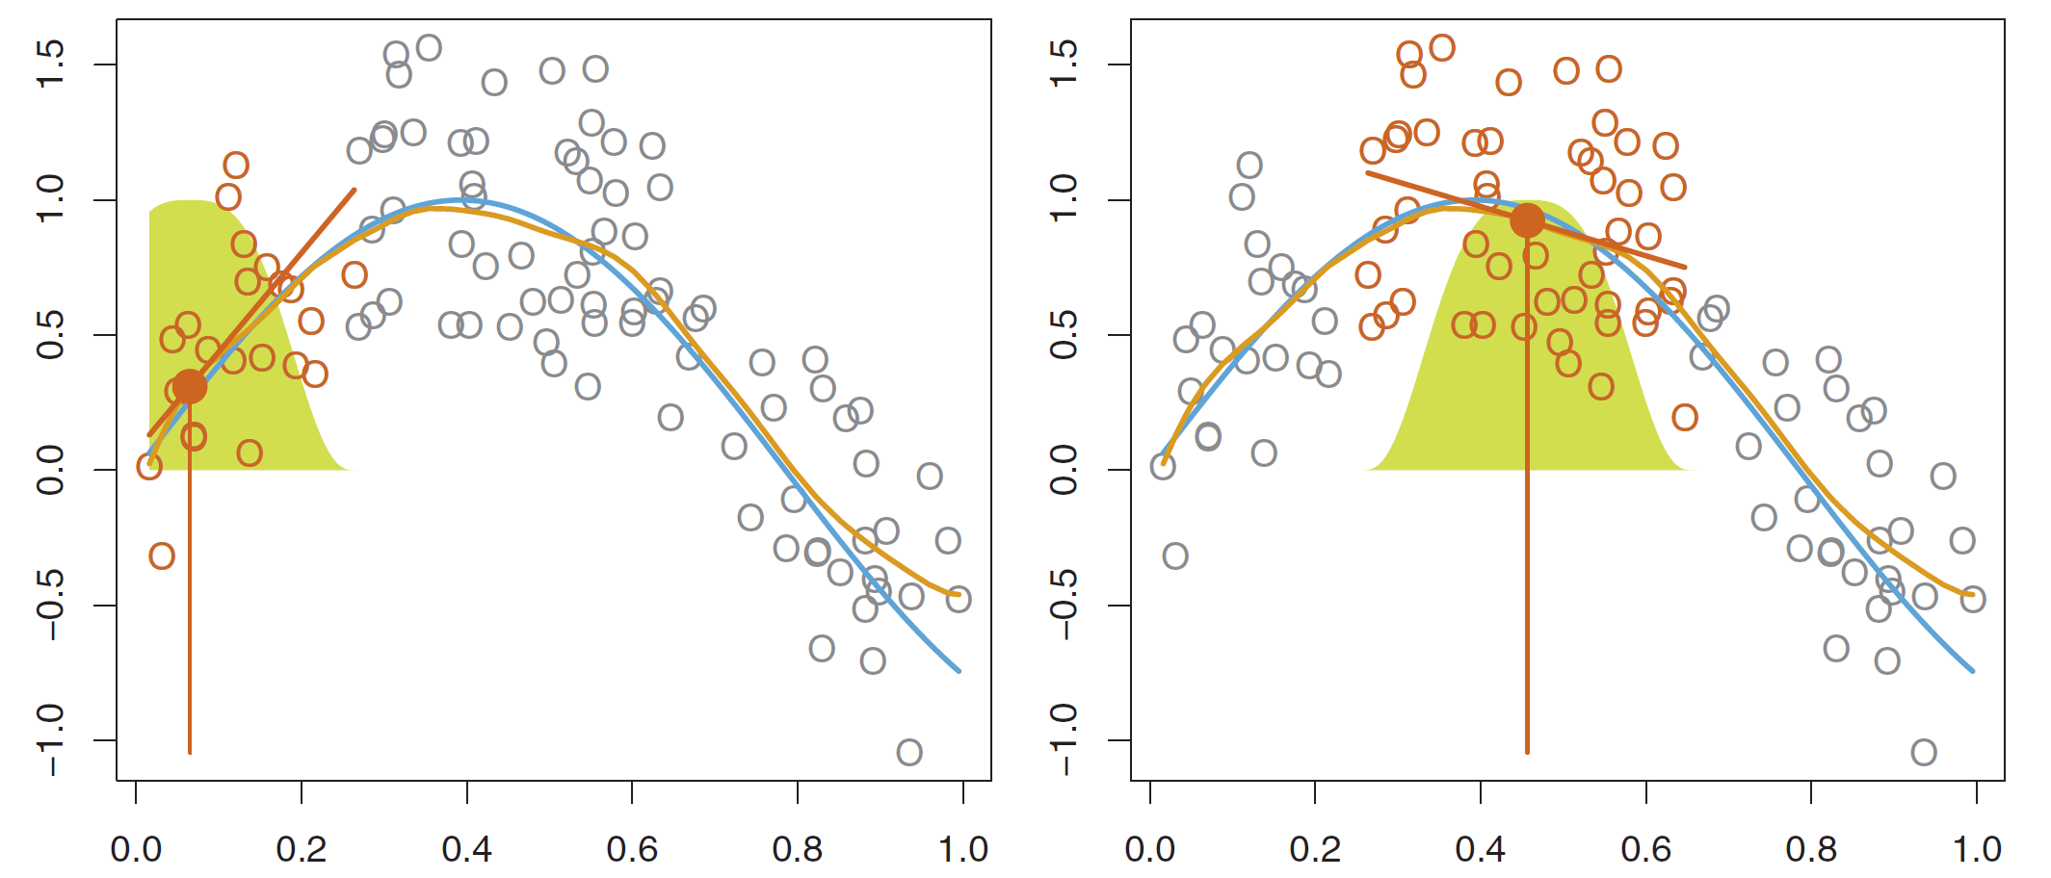

Slide 4
Which Method best fit the data?
Linear regression
Polynomial regression

Slide 5
How about local regression?

Slide 6
Raw Data with neighbors of X=3 highlighted
Lowess compared to linear regession
Notes:
Alternative is polynomial

Slide 7
Algorithm for Local Regression
Gather fraction S of the observation (training points) with X_{i} close to X₀
Assign a weight to each point in the neighborhood.
The closest points have higher weight.
The furthest point has weight of zero
Fit Weighted least regression of y_{i} on X_{i} using these weights
The fitted value at X₀ is
Notes:
Span is the fraction

Slide 8
Local Regression :
Used weighted least squares regression model
A new model for each new point
Can generalize naturally in two dimensional space (bivariate model)
Similar to nearest neighbors in:
A memory based procedure i.e. it need all training data every time you need prediction
Perform poorly in high dimensional space (> 3 or 4) –few observation close to X₀
Notes:
Weighted least square regression a solution to heteroscasticity
Imp generalization about local regression is Fitting a multiple linear model that is global in some variables and local in another
Also it generalizes very naturally when we want to fit a model in relation to tow variables x1, x2 rather than one

Slide 9
Choices for model building:
Span S determine the flexibility of the model (similar to Lambda tunning parameter for the spline)
Small S: local and wiggly fit
Large S: more global fit
Can be determined based on cross validation or specify directly
Weighting function K
Choose to fit a Linear, constant, or quadratic regression
Notes:
Span s is like lambda tunning parameter. It determine the flexibility of our model.
More global fit –all training set
Specify directly When you write the program
Span is too small (insuffieicnt dat fall within the window) curve with a lot of noise. A large variance
While span too large, the regression will be oversmoothed and thus local polynomial may not fit the data well –large bias
Typically s is chosen by trial and error until most of the noise removed or more systematically using loess regression (range.3-.8)
We want the smoothest fit with the smallest s .
Loess s is .75, lowess f=2/3
Degree of polynomial is also affect bias variance tradeoff – higher polynomia is less bias high variability because more co
efficients
These are the 2 commons local regressions one.
Quadratic is loess, Linear is Loewss:
-local linear has more bias but less variance especially at the boundaries. Cubic and higher not improve the fit that much
Therefore it is best to chose less degree of polynomia than the best bandwidth
Wikipedia is : smooth curve through a set of data points obtained with this statistical technique is called a Loess Curve, particularly when each smoothed value is given by a weighted quadratic least squares regression over the span of values of the y-axis scattergram criterion variable. When each smoothed value is given by a weighted linear least squares regression over the span, this is known as a Lowess curve; however, some authorities treat Lowess and Loess as synonyms.

Slide 10
Source: reference no. 1

Slide 11
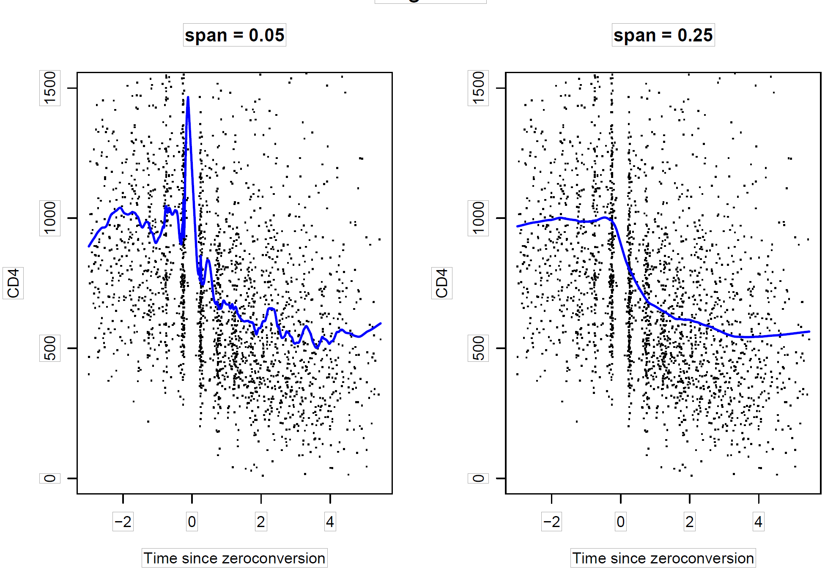

Slide 12
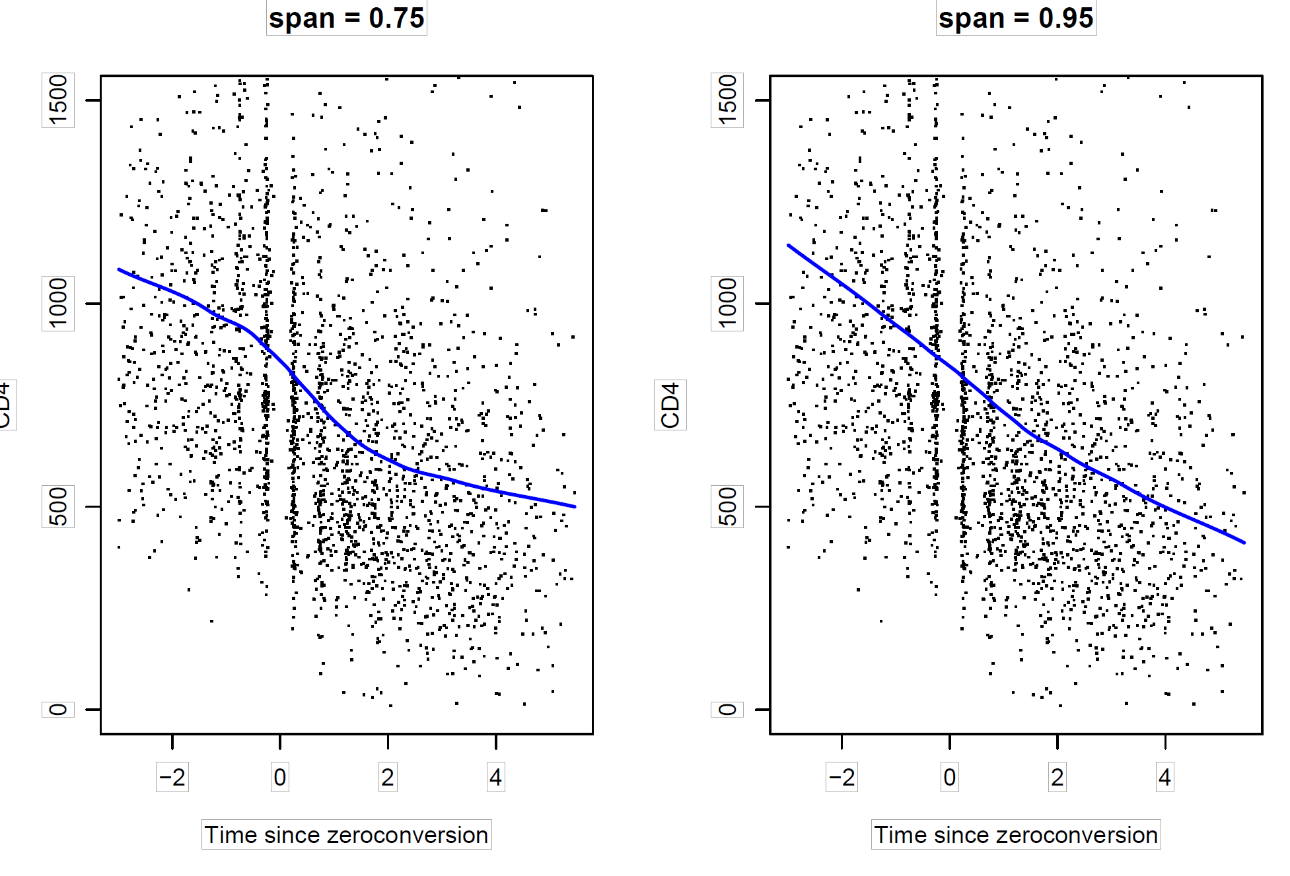

Slide 13
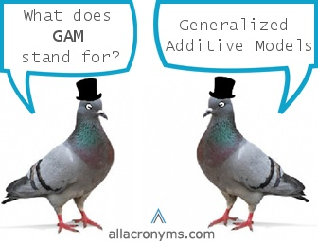
GAM
Source: see reference
Notes:
GAM found by hastie and Tibshirani in 1990 (2 of the authors of the book)

Slide 14
Generalized Additive Models (GAMs)
Fitting a flexible prediction of response Y based on multiple predictors
Can be based on any of the previous methods (building blocks)
Extension of multiple linear model.
Allow non-linear function of each predictor, while it maintain additivity
Can be applied for quantitative and qualitative response variable.
A useful compromise between linear (relatively inflexible) and non parametric models (random forest, boosting.. Which are more flexible)
Notes:
Previuos approaches explain single predictor
F is unspecified parametric function could be a non linear form
Fj’s are Arbitary univariate function, one for each variable
Venables and Ripley (2002, Section 11.5) make an interesting classi- fication of nonlinear models into those that are less flexible but under full user control (fully parametric), and those that are black box tech- niques that are highly flexible and fully automatic: stuff goes in, stuff comes out, but we’re not privy to the specifics29.
Two examples of the latter that they provide are projection pursuit and neural net models, t

Slide 15
Models Summary
Source: reference no. 3

Slide 16
Source: reference no. 2

Slide 17
Source: reference no. 2

Slide 18
Source: reference no. 2

Slide 19
GAMs for regression problems
A natural way to extend the multiple regression models
While in GAMs, we calculate a separate f_{j} for each X_{j}:
This GAM model could be a big regression matrix of any set of basic functions such as spline basic variables and dummy variables , we could also use polynomial or local regression.
Smoothness of fj for Xj variable summarized using degree of freedom.
Notes:
Both are additve function:

Slide 20
Example
Source: reference no. 1
natural spline (4,5 df)

Slide 21
In smoothing spline, GAM can not used least squares but backfitting:
Fit a model involve multiple predictor, by repatedly updating the fit for each predictor in turn, keeping the others constant .
We apply a fitting method for the particular variable to partial residual
Fit f₃ by treating this residual as a response variable in a non-linear regression on X₃ [we know f₁ , f₂ ]

Slide 22
Example
Source: reference no. 1
Smoothing spline (4, 5 df)
Notes:
The differneces are small between natural and smoothing splines

Slide 23
GAMs for Classification Problems
Qualitative Y: Zero or 1
P(x)= Pr(Y=1 | x)
While in logistic regression, the logit is a linear function of the predictors:
In GAM, we use non linear relationship
Notes:
conditional probability of Y=1 given the predictor X

Slide 24
GAMs for Classification Problems
Source: reference no. 1
Notes:
1) lineaallow us to visually assess the relative contribution of each of the variables (age, and education) have a much higher effect on the probability of being a highr earner than year

Slide 25
GAMs for Classification Problems
Source: reference no. 1
Linear function
Notes:
1) line aallow us to visually assess the relative contribution of each of the variables (age, and education) have a much higher effect on the probability of being a highr earner than year

Slide 26
GAMs for Classification Problems
Smoothing spline with 5 df function
Source: reference no. 1
Notes:
1) lineaallow us to visually assess the relative contribution of each of the variables (age, and education) have a much higher effect on the probability of being a highr earner than year

Slide 27
GAMs for Classification Problems
Source: reference no. 1
Step function (dummy variables)
Notes:
1) lineaallow us to visually assess the relative contribution of each of the variables (age, and education) have a much higher effect on the probability of being a highr earner than year

Slide 28
Pros of GAMs
Allow us to fit a non-linear f_{j} for each X_{j}
GAM model non-linear relationships that standard linear regression will miss
No need for manual trying of different transformations on each variable individually.
The non-linear fits can potentially make more accurate predictions for the response Y .
Useful for inference:
GAM’s model is additive, we can still examine the effect of each Xj on Y individually while holding other variables fixed.
Notes:
Linear model is easy/ simple to fit, results are easy to understand/interpret, and there is a wide variety of techniques used for test in the assumptions involved.
-linear model should not be apllied/used in cases of an intrinsic non linearity of dats
-non parametric regression provide a useful way to enhance scatterplot to display underlying structure of the data , play an important role in diagnosistic plots
-entirely relaxing the linearity assumption

Slide 29

Cons of GAMs cont…
Additivity is the main limitation –important interaction missed-
Source: see reference

Slide 30

Cons of GAMs cont…
Additivity is the main limitation –important interaction missed-
But: we can manually add interaction terms (as for linear regression)
Source: see reference

Slide 31
Local regression and GAM models in R
You will need the following packages:
Modreg for local regression [Loess() function] or lowess() in {base}, locfit() {locfit}
Splines for GAM with natural splines only [ ns() function]
GAM for GAM model with smoothing splines [ s() function ], local regression [ lo() function]
Plotting using plot.gam {GAM}, plot {Akima}
I() function for dicotomy [Base]
Note: in SAS use Proc GAM for the regression and Proc g3d for the graphs
Notes:
Local weighted smoothing scatterplot
Local regression: later generalization of Loess
Locfit use local AIC to get best fit

Slide 32
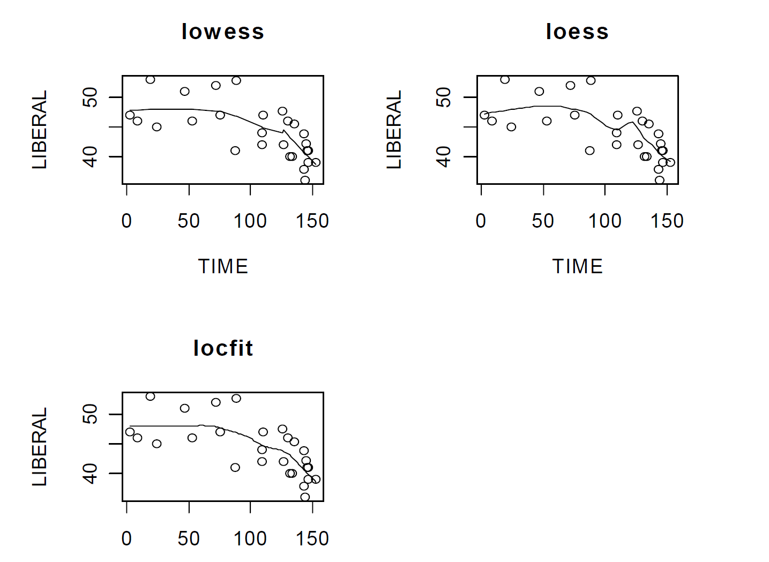

Slide 33
Lists of R packages
How to do GAM in R?
Source: reference no. 3

Slide 34
How to do GAM in R?
List of R packages cont…
Source: reference no. 3

Slide 35
GAMs
Incorporate nonlinear predictor effects into otherwise linear models.
Keep within the linear and generalized linear frameworks.
new avenues of model exploration with possibility of improved results.
Notes:
Generalized linear more familiar and easier interpretable, GAM is conceptually straight forward

Slide 36

Source: see reference

Slide 37
References
An Introduction to Statistical Learning by Gareth James et al., Springer 2013
Generalized Additive Model by Huimin Liu, U of Minnesota- Duluth 2008
Generalized Additive Models by Michael Clark, U of Notre Dame 2012
Images :
Pigeons: http://www.allacronyms.com/_medical/GAM/Generalized_Additive_Models
Simpson: https://lmdaviswrites.wordpress.com/2014/08/25/ and https://spring2013animationseminar.wordpress.com/2013/02/15/february-20-david-isaacs/
Thank You: http://blogs.imediaconnection.com/files/2013/11/owl-chalkboard-thank-you.png

